Slide 1

Trees in Real world
Trees in Computer Science

Slide 2
Contents
Introduction to Trees
Properties of trees
Type of trees
Binary search tree
    Insert
    Search
    Delete
    Traversal
      Pre-order
      Post-order
      In-order

Slide 3

Tree data structure
A tree is a graph containing nodes(data) and connections(edges) without a cycle.
A rooted tree is a tree data structure in which
  one node is designated as the root
  every other node in the tree has a single unique path to this root.
  This means that the tree has a hierarchical structure with a clear starting point at the root
A few applications :
  Searching – Example Binary Search
  Sorting – Example heap sort
  Machine learning – Decision tree
  Indices for databases – B-tree

Slide 4
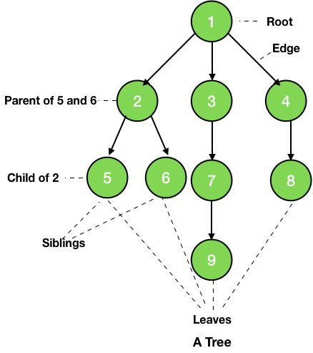
Terminology
  Node: A basic unit of a tree that contains data and links to other nodes.
  Root: The top node in a tree, the prime ancestor.
  Child: A node directly connected to another node when moving away from the root, an immediate descendant.
  Sibling: Children of the same parent.
  Parent: The converse notion of a child, an immediate ancestor.
  Leaf: A node with no children. Also called as terminal node.
  Internal node: A node with at least one child.

Slide 5
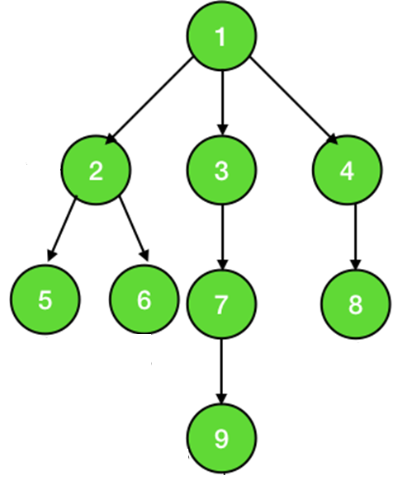
Properties of tree
Level=0
  Level of node: The number of edges from the root to leaf a specific node. Level of the root is 0.
  Height of a tree: The number of edges on the longest path from the root to a leaf.
  The height of the tree in figure is 3.
  Breadth: The number of leaves.
  The breadth of the tree in the figure is 4
  Uniqueness of Path: There is exactly one unique path between any two nodes in a tree.
Level=1
Node | 1 | 2 | 3 | 4 | 5 | 6 | 7 | 8 | 9
Level | 0 | 1 | 1 | 1 | 2 | 2 | 2 | 2 | 3
Level=2
Leaf
Leaf
Leaf
Longest path from root
Level=3
Leaf

Slide 6
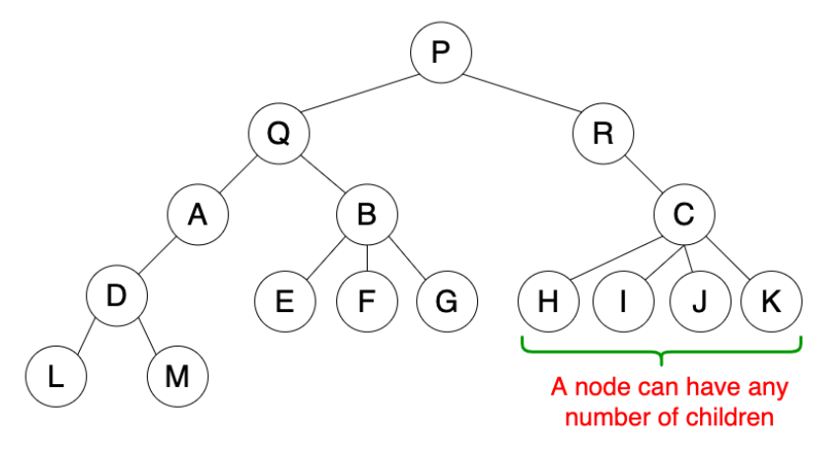
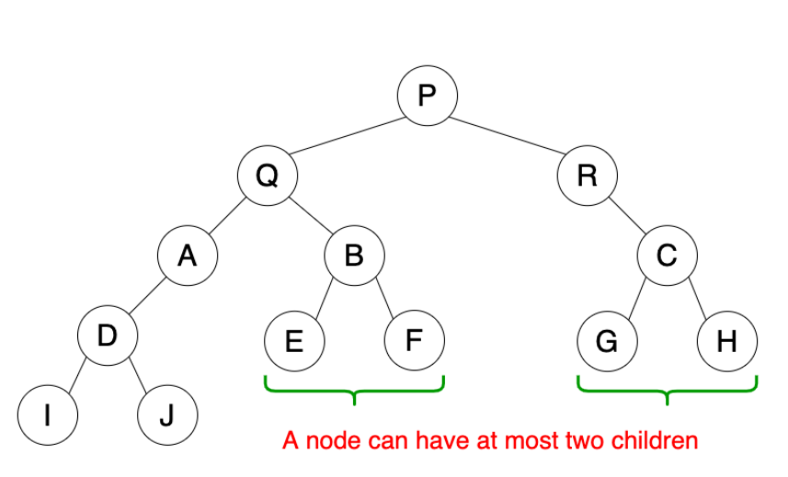
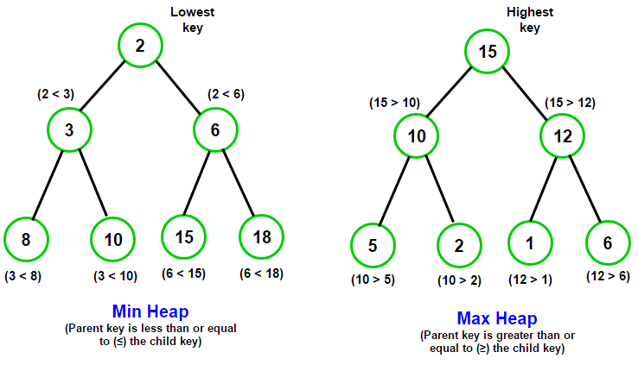
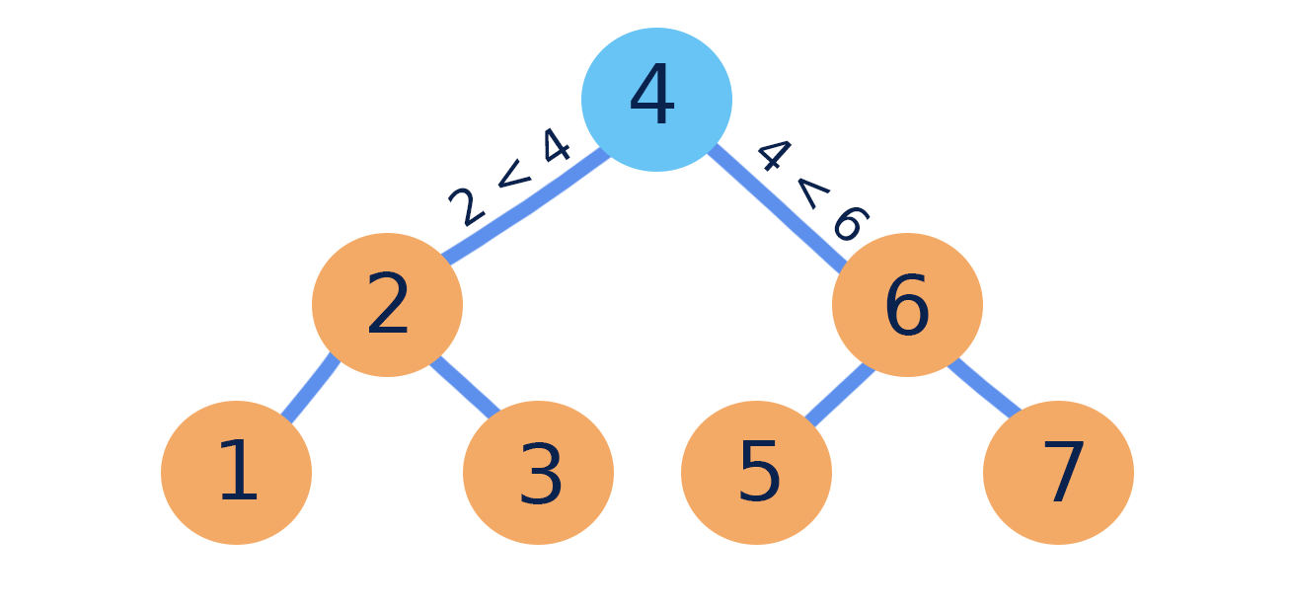
Type of Trees
General tree
Binary tree
Binary Heap
Binary Search Tree(BST)
Left child <= parent and Right child >= parent

Slide 7
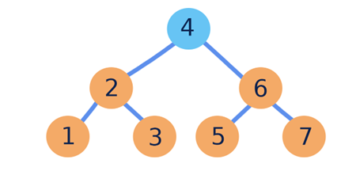
Implementation of BST
  root
  Basic unit: Node
left
data
right
  Abstract Data Type: Node
  Abstract Data Type: BinarySearchTree
Attributes
  data
  left
  right
Operations
  CreateNode
  Attributes
    root
  Methods
    CreateBST
    Insert Node
    Traversal
    Search
    Delete Node

Slide 8
Implementation using C#
class Node
{
public int data;
public Node left,right;
// Constructor
public Node (int item)
{
data = item;
left = right = null;
}
}
class BinarySearchTree
{
public Node root;
public BinarySearchTree()
{
root = null;
}
public Boolean isEmpty()
{
return (root == null);
}
}
  root
Creation of a node named root:
Node root=new Node(20)
20
null
null

Slide 9
Insert Elements into bst
Elements to be constructed in a tree:
32, 12, 23, 36, 39, 33
32
32
null
null
12
null
null
null

Slide 10
Insert Elements into bst
Elements to be constructed in a tree:
32, 12, 23, 36, 39, 33
32
32
12
null
12
null
null
null
null
23

Slide 11
Insert Elements into bst
Elements to be constructed in a tree:
32, 12, 23, 36, 39, 33
32
32
12
null
12
36
null
23
null
23
null
null

Slide 12
Insert Elements into bst
Elements to be constructed in a tree:
32, 12, 23, 36, 39, 33
32
32
12
36
12
36
null
23
null
null
null
23
null
39

Slide 13
Insert Elements into bst
Elements to be constructed in a tree:
32, 12, 23, 36, 39, 33
32
32
12
36
12
36
null
23
null
39
null
23
33
39

Slide 14
Insert Elements into bst
public void insert(int element)
Node newNode = new Node(element);
if (root == null){ //If the tree is empty, the new node becomes the root
root = newNode;
return;
}
Node current = root; // Start at the root
Node parent = root; // Keep track of the parent node
while (current != null){ // Traverse the tree
if (element < current.data){ // Move to the left subtree
parent = current;
current = current.left;
}
else if (element > current.data){ // Move to the right subtree
parent = current;
current = current.right;
}
else { // Duplicate values are not allowed in this BST
Console.WriteLine("Element already exists");
return;
}
}
32
12
36
null
23
33
39
// Insert the new node as a child of the parent
if (element < parent.data)
parent.left = newNode;
else
parent.right = newNode;
}// end insert

Slide 15
Traversal of a BST
Tree Traversal refers to the process of visiting or accessing each node of the tree exactly once in a certain order.
Traversal algorithms always traverse left subtree before right subtree.
There are three traversals
  In order traversal
  Pre order traversal
  Post order traversal
32
12
36
23
33
39

Slide 16
traversals
32
In order
left subtree – root – right subtree
12
36
pre order
root – left subtree – right subtree
23
33
39
post order
left subtree – right subtree – root
Nodes visiting order
Inorder: 23, 12, 33, 39, 36, 32
pre order: 32, 12, 23, 36, 33, 39
post order: 23,12, 33, 39, 36, 32

Slide 17
In order traversal
32
visit left subtree in inorder
visit root
visit right subtree in inorder
12
36
23
33
39
public void inorderTraversal(Node root){
if (root != null){
inorderTraversal(root.left);
Console.Write(root.data + " ");
inorderTraversal(root.right);
}
}
Nodes visiting order : 12, 23, 32, 33, 36, 39
Nodes are visited in ascending order for BSTs

Slide 18
Pre order traversal
32
visit root
visit left subtree in preorder
visit right subtree in preorder
12
36
23
33
39
public void preorderTraversal(Node root){
if (root != null){
Console.Write(root.data + " ");
preorderTraversal(root.left);
preorderTraversal(root.right);
}
}
Nodes visiting order : 32, 12, 23, 36, 33, 39

Slide 19
post order traversal
32
visit left subtree in inorder
visit right subtree in inorder
visit root
12
36
23
33
39
public void postorderTraversal(Node root){
if (root != null){
postorderTraversal(root.left);
postorderTraversal(root.right);
Console.Write(root.data + " ");
}
}
Nodes visiting order : 23, 12, 33, 39, 36, 32

Slide 20
Search for an element in BST
Search method in BST returns True if the search element exists in the BST. Otherwise, it returns False.
32
public Boolean search(int element, Node root){
if (root == null)
return false;
else
if(root.data == element)
return true;
else
if (element < root.data)
return search(element, root.left);
else
return search(element, root.right);
}
12
36
null
23
33
39

Slide 21
Delete a node from BST
Search for the node to be deleted
Case 1: If the node is a leaf:
  Set its parent's reference to null
  Delete it.
Case 2: If the node has one child:
  Replace the node with its child.
  Delete the child node (which is leaf node)
Case 3: If the node has two children:
  Find the in-order successor (minimum value in the right subtree).
  Copy the successor's value to the node.
  Delete the node in the successor position. whic is a leaf node)
32
12
36
23
33
39
Nodes visiting order in inorder traversal
12, 23, 32, 33, 36, 39

Slide 22
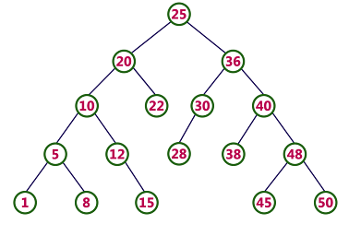
Get Inorder Successor of a node in BST
public Node getSuccessor (Node curr){
Node current = curr.right;
while (current != null && current.left != null)
current = current.left;
return current;
}
32
12
36
23
33
39

Slide 23
Delete node from BST
public Node delete(int element, Node root){
if (root == null) // Base case
return null;
if (element < root.data) // element may be available in left subtree
root.left = delete(element, root.left);
else
if (element > root.data) // element may be available in right subtree
root.right = delete(element, root.right);
else { // element is present in root’s data
if (root.left == null) // root has only right child
return root.right;
if (root.right == null) // root has only left child
return root.left;
// When both children are present
Node succ = getSuccessor(root);
root.data = succ.data;
root.right = delete(succ.data, root.right);
}
return root;
}

Slide 24


